Slide 1

Big feelings neurodiversity
EMOTIONAL REGULATION
HOW TO SUPPORT NEURODIVERGENT CHILDREN WITH EMOTIONAL PROCESSING AND ANXIETY
Psychology in Schools Team, Norfolk and Suffolk NHS Foundation Trust
With thanks to Essex Partnership for Inclusion of Neurodiversity in Schools - Essex Child and Family Wellbeing Services, Essex Family Forum, Essex Child and Adolescent Mental Health
Service (CAMHS) and Suffolk Parent Carer Forum (SPCF)

Slide 2

How would you rate your current knowledge of big feelings in neurodivergent children?

Slide 3
How would you rate your current confidence supporting neurodivergent children/young people with managing big feelings?

Slide 4
Big feelings neurodiversity
EMOTIONAL REGULATION
HOW TO SUPPORT NEURODIVERGENT CHILDREN WITH EMOTIONAL PROCESSING AND ANXIETY
Psychology in Schools Team, Norfolk and Suffolk NHS Foundation Trust
With thanks to Essex Partnership for Inclusion of Neurodiversity in Schools - Essex Child and Family Wellbeing Services, Essex Family Forum, Essex Child and Adolescent Mental Health
Service (CAMHS) and Suffolk Parent Carer Forum (SPCF)

Slide 5

Looking after yourself
Emotional topics being covered today, including self-harm and suicide
Do what you need to look after yourself
Recording and resources will be shared with everyone who signed up for the workshop

Slide 6
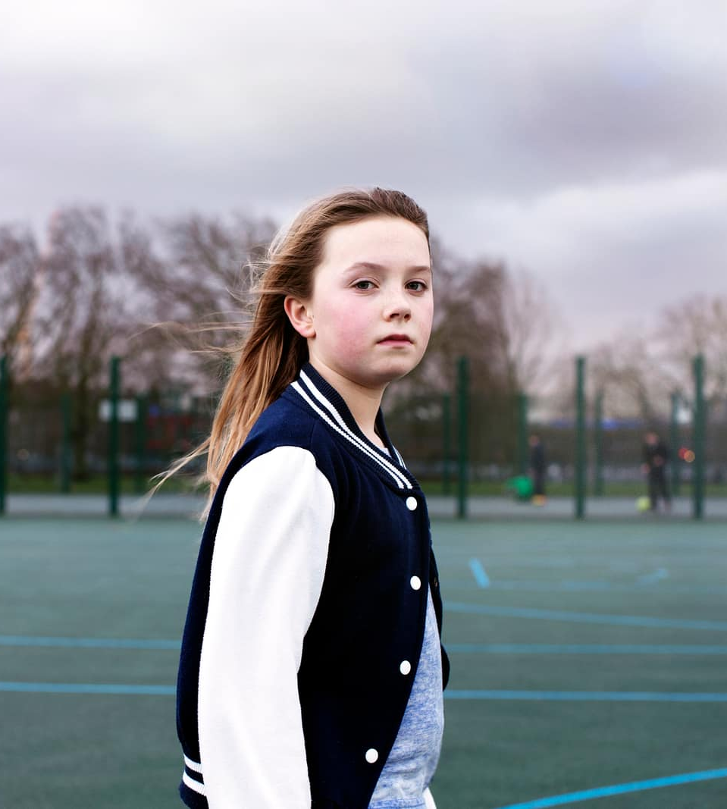
Workshop Overview
WHAT is the prevalence of anxiety, low mood, self-harm and suicidality in neurodivergent children?
WHY might neurodivergent children need more support with their big feelings?
HOW can you and others help your child manage their big feelings?

Slide 7
Mental health in neurodivergent children and teenagers
Increased risk of mental health problems
Increased risk of depression
Increased risk of anxiety

Slide 8
Increased risk of self-harm and suicide
Statistics indicate that the risk of self-harm and suicidal thinking and attempts are sadly higher for neurodivergent children
For some families, helping managing risk of self-harm is an important part of supporting their neurodivergent child with their emotions

Slide 9

What protects against poor mental health and wellbeing?
Special interests
Having a sense of shared connection
Self-acceptance
Neuroaffirmative approaches and language are key

Slide 10

Why might neurodivergent children need more support with their big feelings?
Emotional literacy
Emotion dysregulation
Environment and experiences
Brain differences in neurodivergent children

Slide 11

Emotional Literacy
Understanding what emotion they are feeling
Communicating to others how they are feeling
Recognising other people’s feelings

Slide 12

WHAT WE MIGHT SEE
Appears fine (masking)
Nauseous
Breaking things
Eating problems
Self-harm
Crying
Violence
Withdrawn
Struggling to attend school
Irritable
Seeking safety
Confused
Needing to feel loved
Shame
Uncertainty
Sadness
Hopelessness
Academic problems
Anger
Lonely
Tired
Bored
Bullying
Low self-esteem
Feeling left out
Sense of difference
Overwhelmed
Sensory overload
In pain
Needing attention
Hunger
Jealousy
Fear
Trauma memories
Friendship fall out
Embarrassed
WHAT MIGHT BE GOING ON FOR A CHILD

Slide 13
Activity: What might trigger your child’s big feelings?

Slide 14
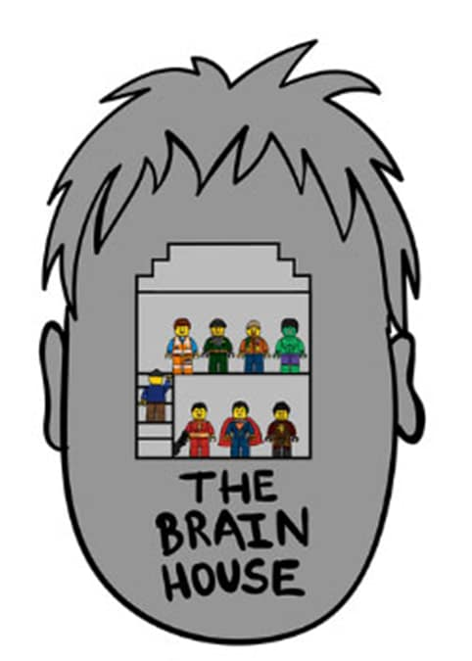
The Brain House
Upstairs brain
The control tower
Downstairs brain
The alarm system
  Illustrated by Dr Hazel Harrison
Dr Dan Siegel

Slide 15
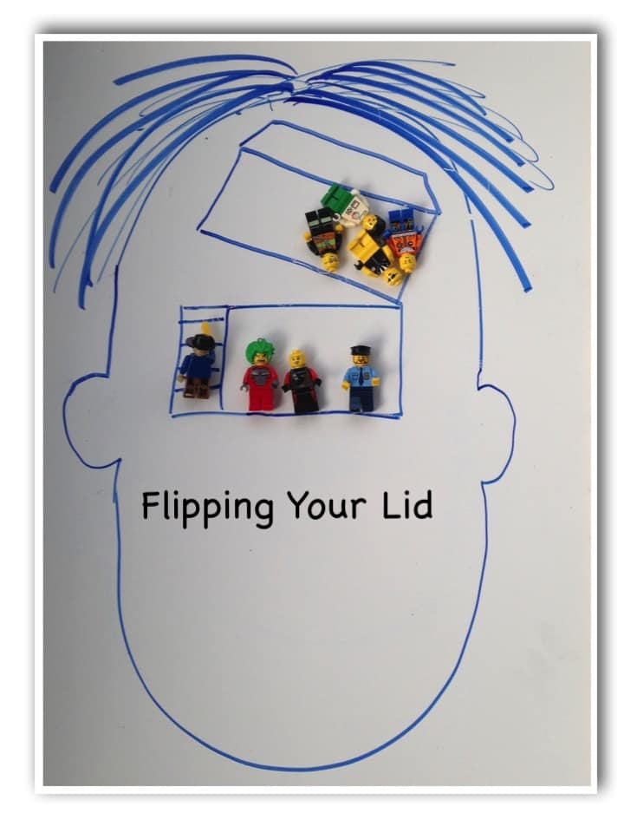
Flipping The Lid
This is what happens when people get overwhelmed by big feelings
We lose access to the upstairs part of our brain
When this happens children no longer have access to the part of their brain that helps them to make good decisions
Dr Dan Siegel

Slide 16






Brain house in neurodivergent children
Processing sensory information
Impulsivity/mind wondering
Emotion regulation
Recognising, differentiating & expressing emotions
More frequent negative experiences
Understanding other’s points of view

Slide 17

Neurodivergent Experiences
School problems e.g. difficulty learning, sensory overwhelm, masking – trying to fit into ‘neurotypical box’ sometimes expected at school
Social difficulties e.g. lonely, friendship problems, bullying, being taken advantage of by peers

Slide 18
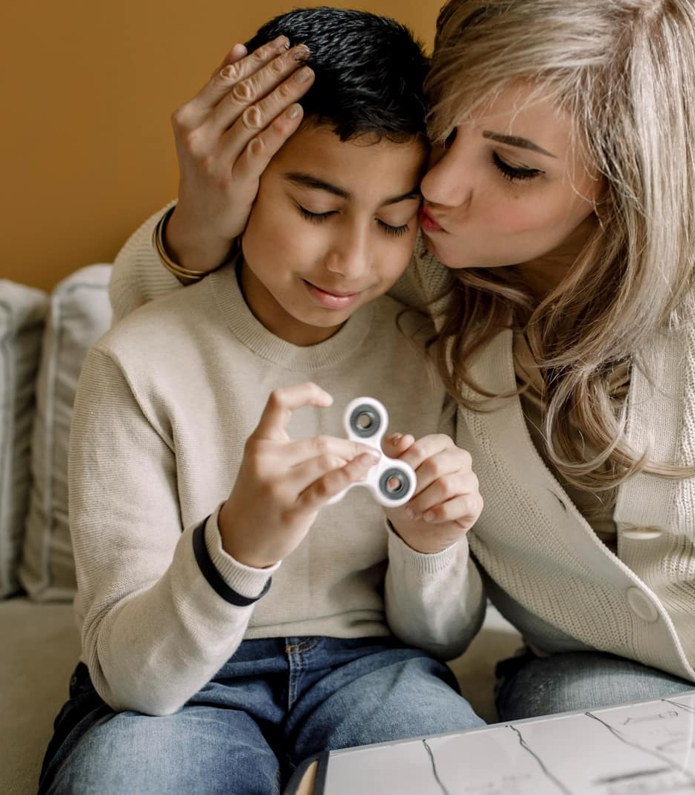
How can you and others help your child manage their big feelings
Connection before correction
Building emotional literacy
Addressing triggers and the importance of neuroaffirmative environments
Calming and relaxation
General wellbeing

Slide 19
Connection before Correction
When children are overwhelmed, they will not be able to hear us until the thinking part of the brain is back online
We can help with this by prioritizing connection over correction
Coming alongside your child to help them regulate, becoming calm before deciding what to do next

Slide 20


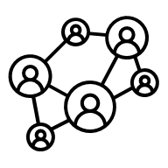



Connecting with neurodivergent children
Connecting at the right time
Be mindful of sensory differences
Connection may look different for neurodivergent children
Give alternate ways of communicating
Incorporate special interests
Doing something they enjoy alongside them

Slide 21
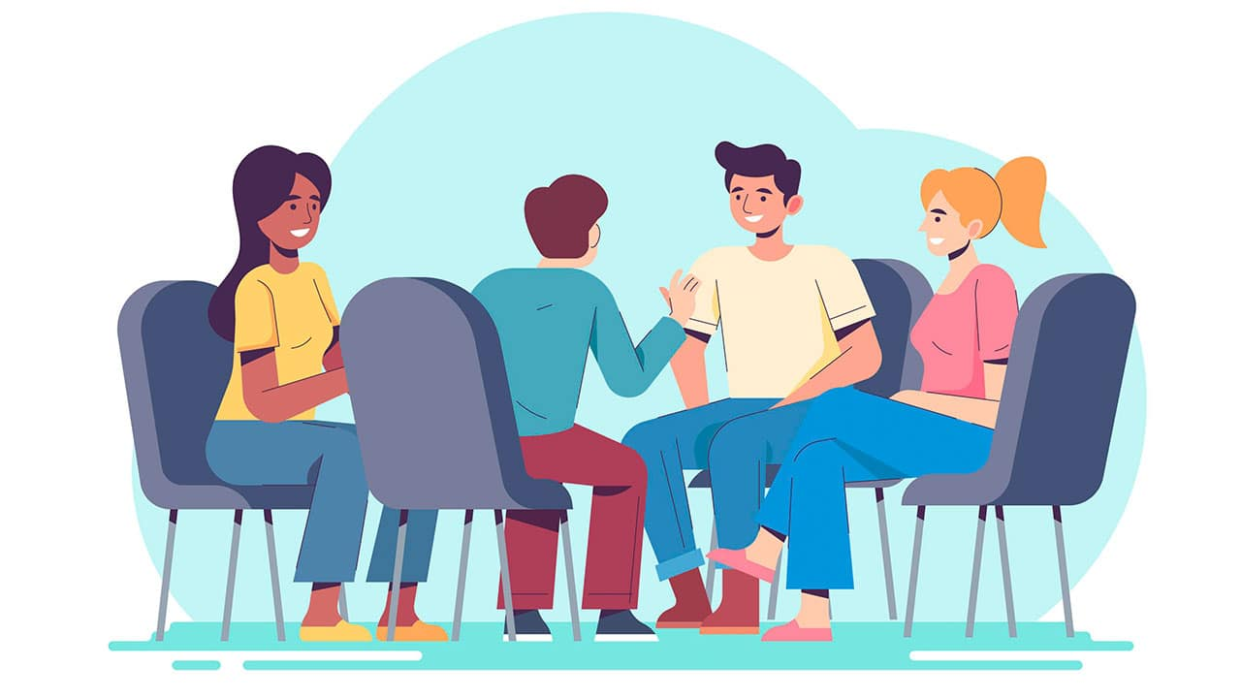
Small group discussion: What makes it difficult for you to do this? What helps you?

Slide 22

Building emotional literacy

Slide 23
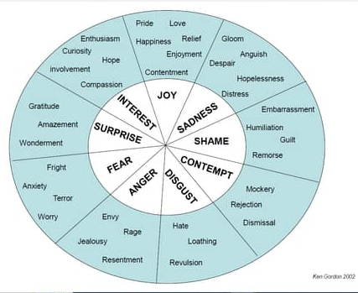
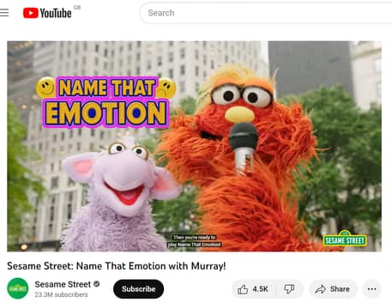

Identifying emotions

Slide 24


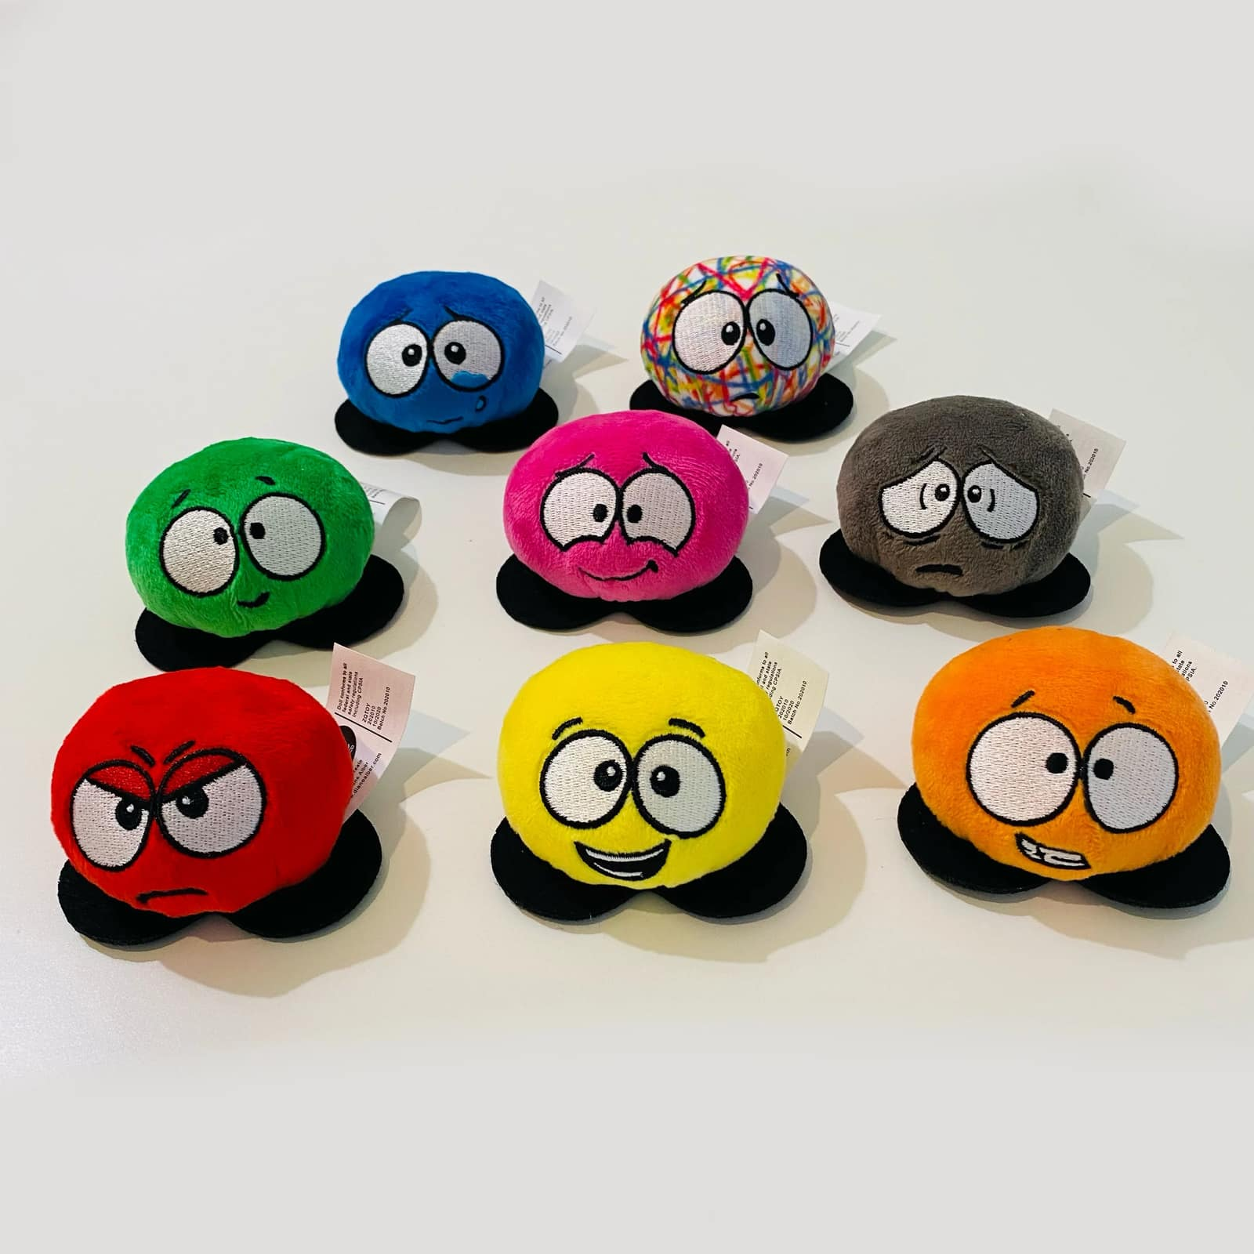
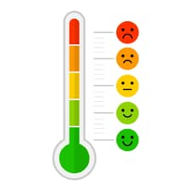
Communicating emotions
www.dianealber.com

Slide 25

Addressing triggers
Work out together what the triggers are
Reducing sensory distress
May need to support your child in navigating their friendships
Increasing social support – clubs based on hobbies, neurodivergent communities, school mentoring/pastoral support
The importance of neuroaffirmative environments

Slide 26

Classroom-based strategies
Teach children about difference and diversity
Whole-class education on neurodiversity and interoception
Encourage understanding
Encourage and model kindness

Slide 27

Working together
Masking at school may mean emotional needs are less obvious
Sharing your understanding and strategies
Consider reasonable adaptations at school – remember needs-based not diagnosis based

Slide 28

Calming and Regulation
Breathing techniques
Grounding techniques - bringing into present moment
Sensory regulation
Safe space

Slide 29
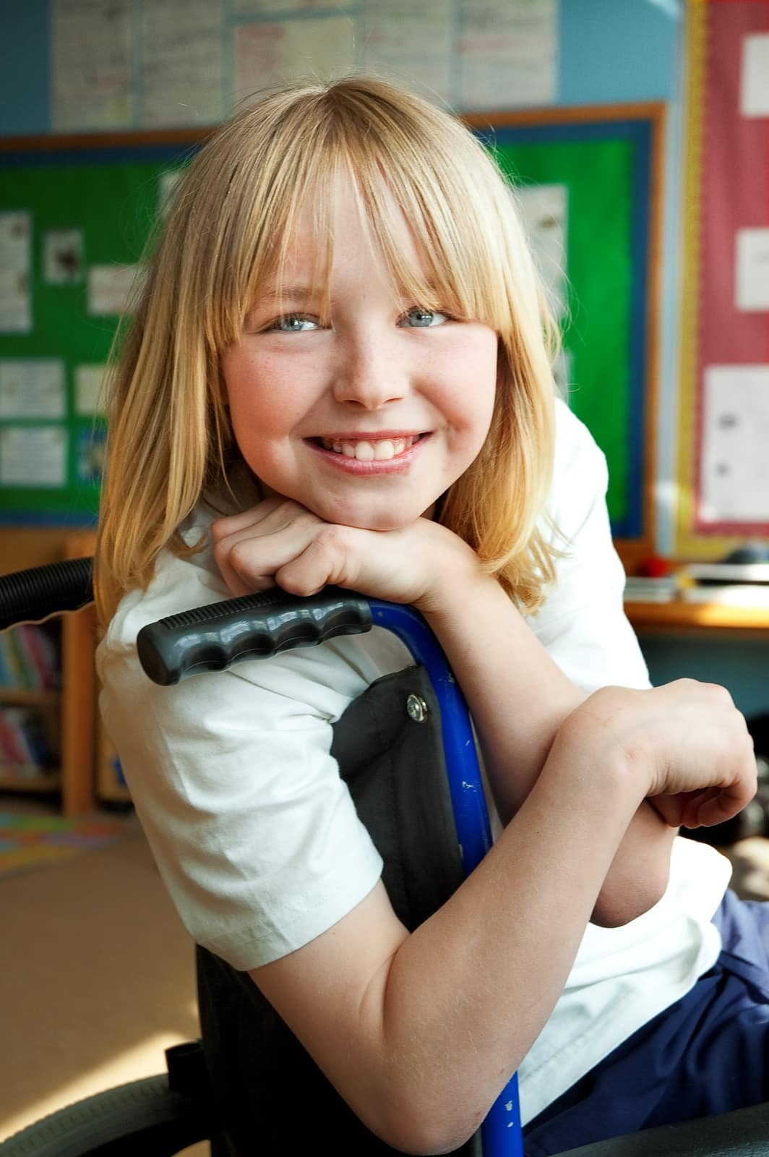
Positive self-talk
Celebrating their successes and strengths
Encouraging and modelling positive self-talk
Being your child’s champion!

Slide 30


Importance of your own wellbeing
If you are feeling dysregulated, it’s very difficult to support a young person to regulate themselves
Filling up our own resource bucket first
Emotional contagion
Childhood Neurodivergence: Managing Parental/Carer Stress
Wellbeing Suffolk:
https://www.wellbeingnands.co.uk/

Slide 31
General family wellbeing
Sleep
Healthy diet
Exercise
Social connection

Slide 32
Small group discussion: What two things will you try do to in the next week?

Slide 33

HOLDING HOPE
“Every child is different. You’ve just got to find what works”
“Keep being curious, become the detective and stay resilient. Be your child’s Ambassador, give them a voice. Everyday is a learning day. Talk to Others and ask for support, remember to take 5 minutes for yourself. Create a WOW board, take a photo of every achievement, don’t try and solve everything at once”
“It's hard to understand how your child is feeling but try to keep calm & don't take it personally. Your child loves you & trusts you the most and therefore feels most comfortable being angry at you more than anyone else.”
“You are not alone”
“Ask for support. Do not try to do things alone”

Slide 34
Key sources of support and resources in Suffolk for parents/carers
Suffolk Local Offer
https://www.suffolklocaloffer.org.uk/
Parenting courses and more:
The Parent Hub - Suffolk County Council
Action for children: Support when you feel like you can’t cope as a parent
Parent/carer networks:
PACT | Parents And Carers Together | Suffolk
Suffolk Parent Carer Forum (suffolkpcf.co.uk)
The Source Engagement Hub:
https://thesource.me.uk/engagement-hub/
Behaviour safe at home – Suffolk SEND Local Offer:
Behaviour safe at Home - Suffolk SEND Local Offer
Two-day course, £10 per person. Look at the link for dates

Slide 35
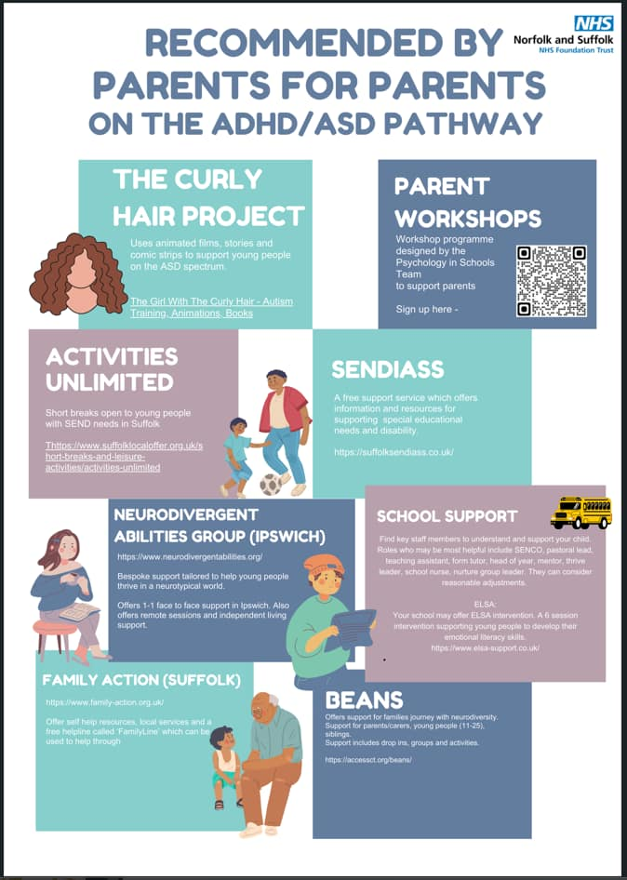
Support in Suffolk continued
SENDIASS
Parent workshops on SEND including:
What is a special educational need (SEN)?
SEN support in schools
EHC Needs Assessment
Preparing for school transitions
Recorded previous workshops on YouTube
Parent & carer information sessions - Suffolk SENDIASS
Suffolk Sendiass – YouTubeFS

Slide 36
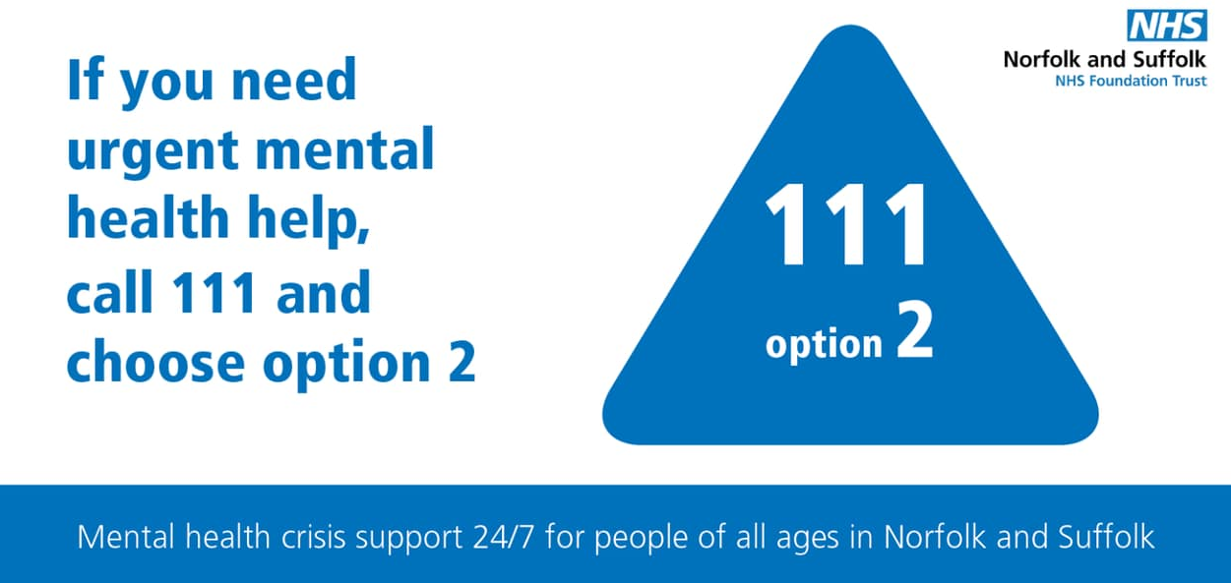
Resources and support
Mental health
YoungMinds mental health charity for children and young people www.youngminds.org.uk
Apps: Headspace, Calm, Combined Mind, Sleepio, Clear Fear (anxiety), Move Mood
The Source information and advice for young people in Suffolk www.thesource.me.uk
Kooth free online counselling for ages 11-25 in Suffolk www.kooth.com
Suffolk Support and self-help guide – local services
Self-harm and suicide
Alumina free online self-harm support group for 11-19 year olds www.selfharm.co.uk
Calm Harm an award-winning app developed to help teenagers manage the urge to self-harm
Papyrus “Supporting your child: self-harm and suicide” a guide for parents and carers www.papyrus-uk.org
MIND urgent help
Suffolk if your child needs urgent mental health support you can call the NHS 111 service on 111 option 2, free service available 24/7

Slide 37
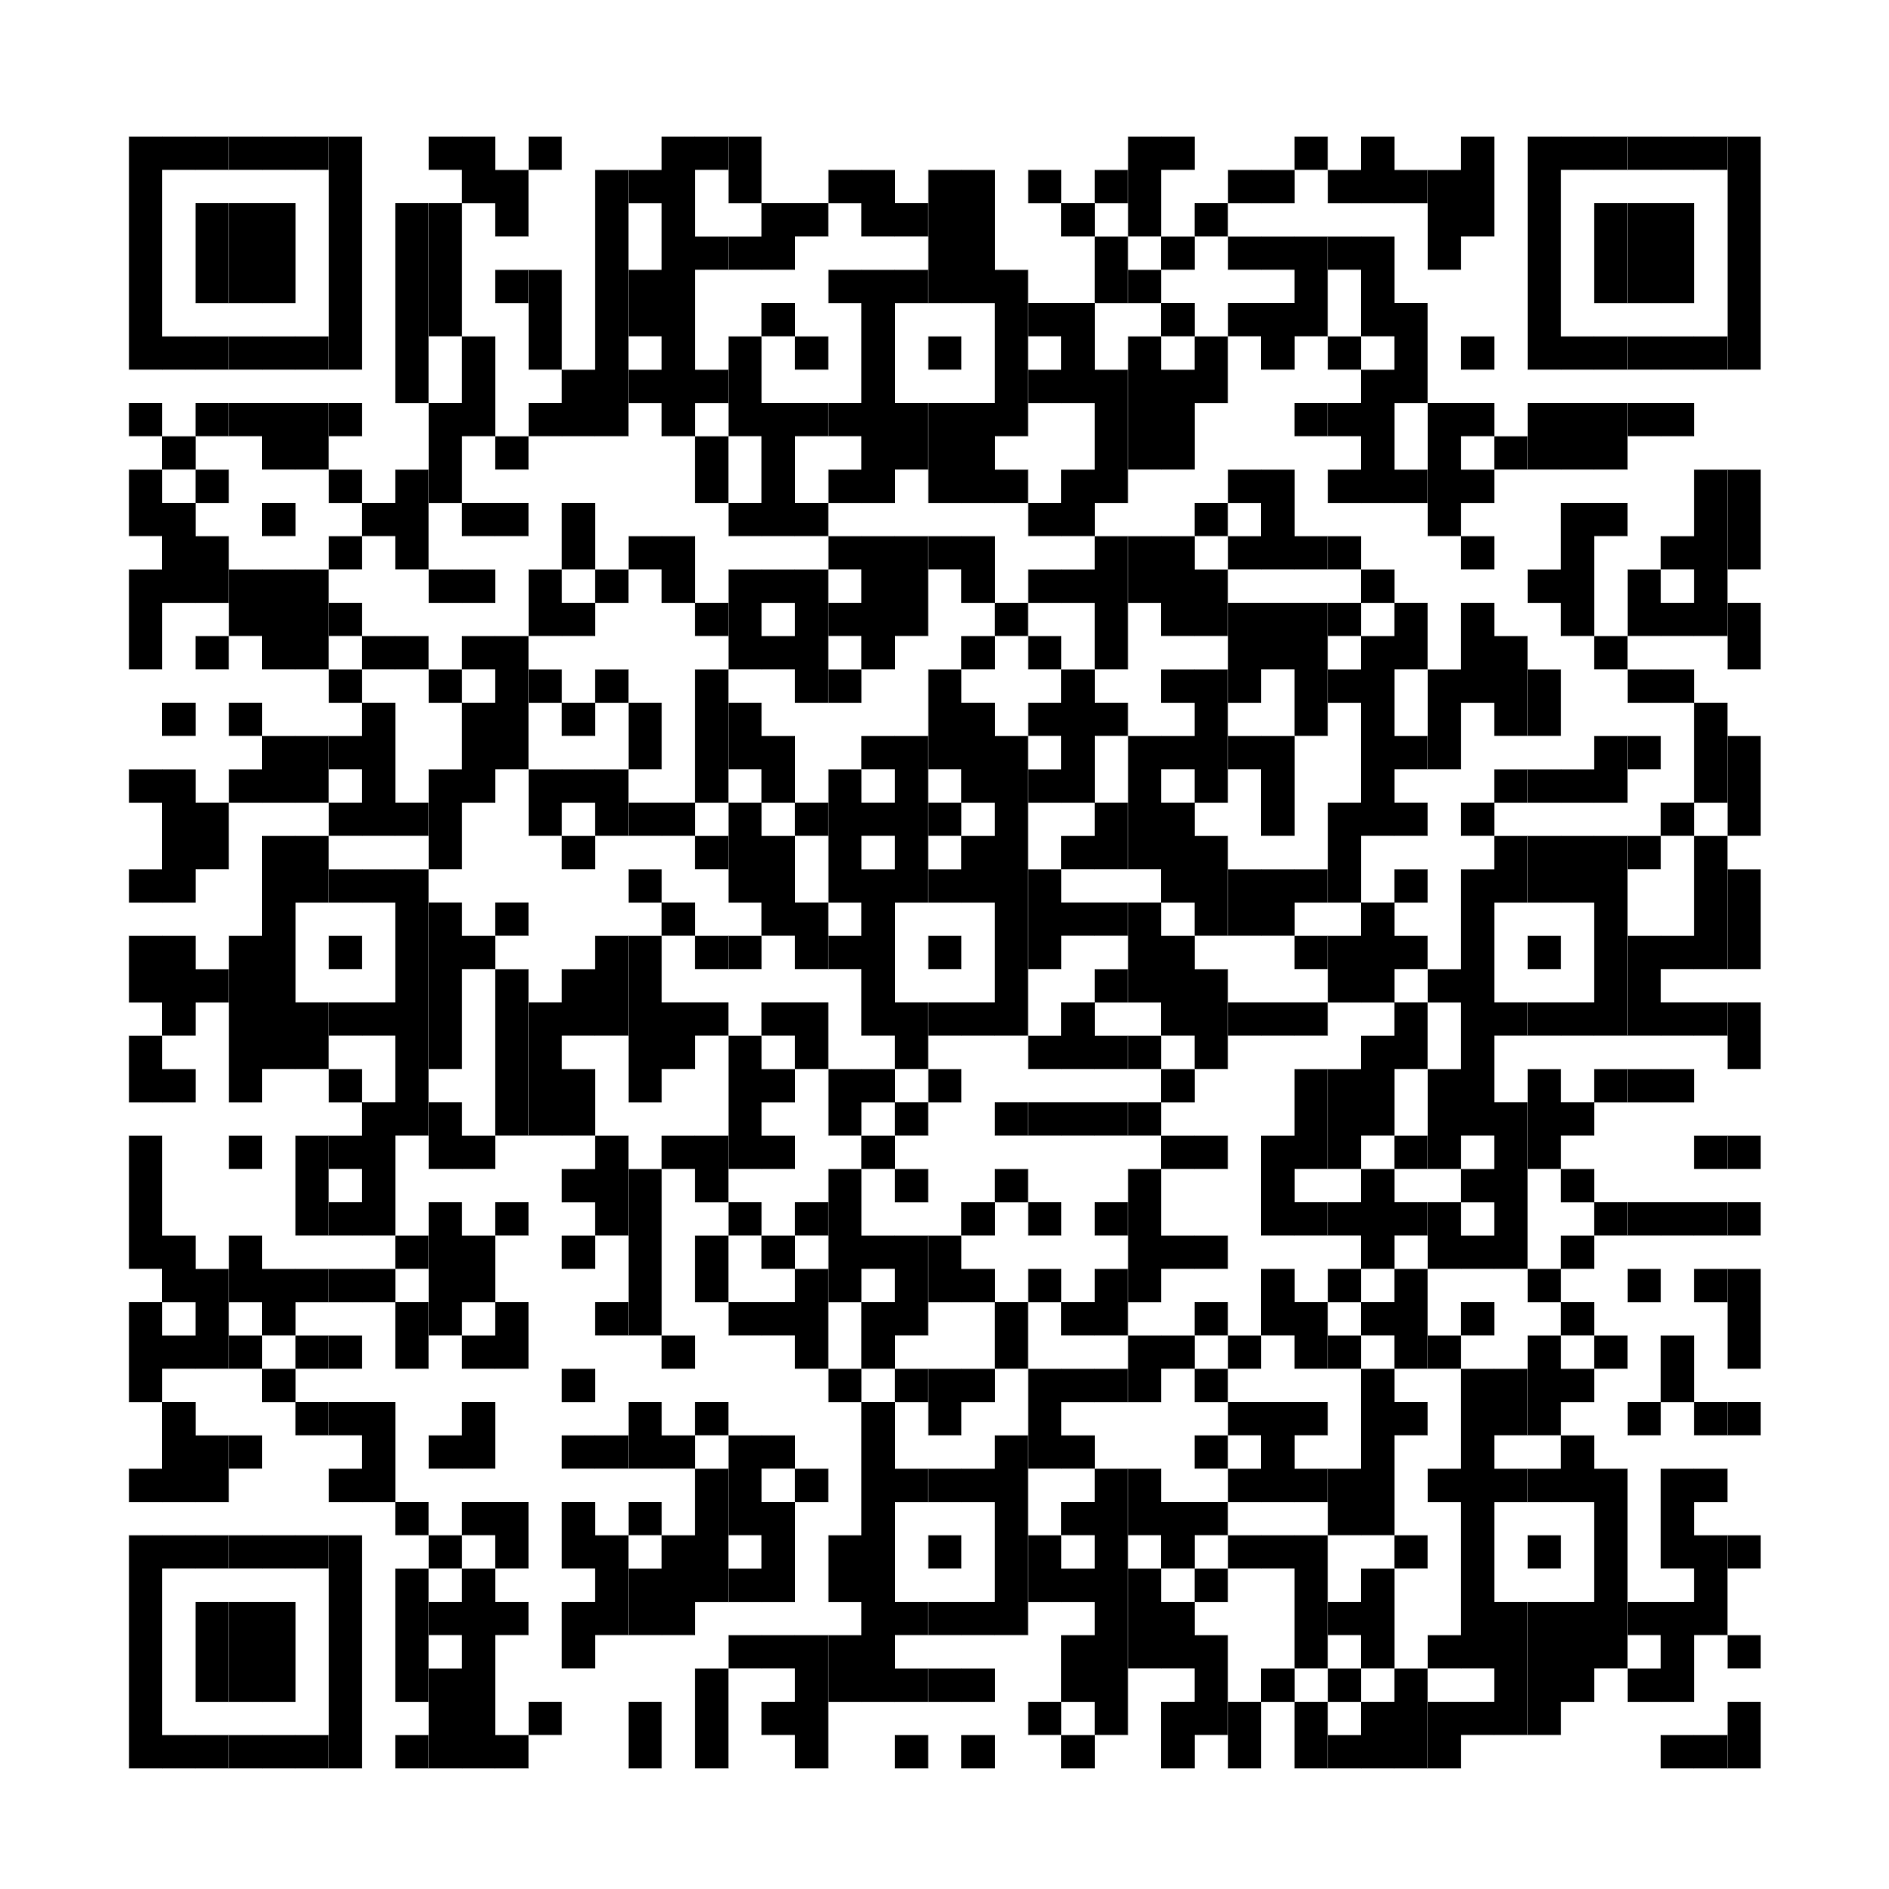
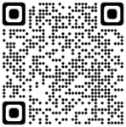
Psychology In Schools: Free Live Workshops And Video Recordings
Upcoming LIVE Parent/Carer
workshops on mental health
www.nsft.uk/workshops
Previous recorded workshops include school avoidance, Tics and Tourette’s, self-harm, supporting behaviour, social media, OCD and more!
Childhood Neurodiversity Workshops:
Previous recorded workshops include supporting sensory needs, eating difficulties, sleep, anxiety, social relationships and more!
Access recorded workshops here:
Parent workshops | Norfolk and Suffolk NHS
Neurodiversity online parent/carer workshops - Suffolk SEND Local Offer

Slide 38
How would you rate your current knowledge of big feelings in neurodivergent children?

Slide 39
How would you rate your current confidence neurodivergent children with big feelings?

Slide 40
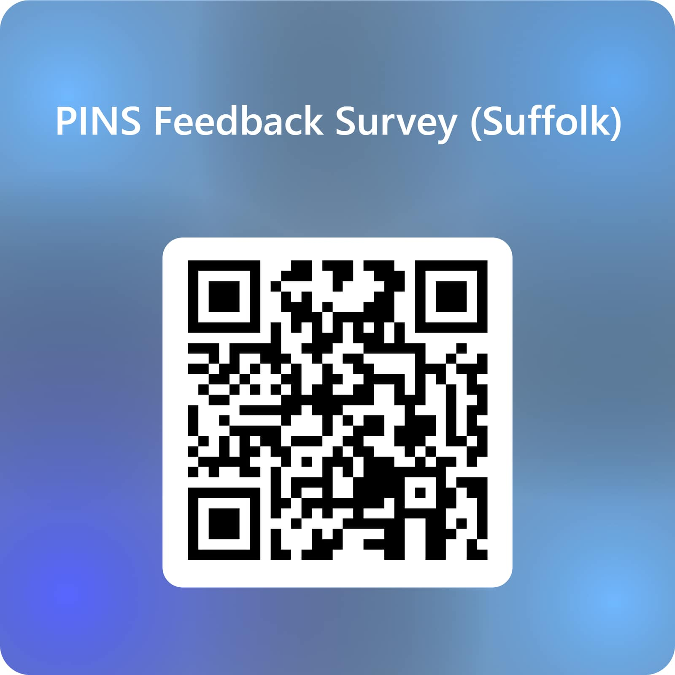
Feedback form
click here

